Slide 1

Azure Load Balancers

Slide 2











Arun Ramaswamy
Azure Cloud Architect
ATOS India

Slide 3
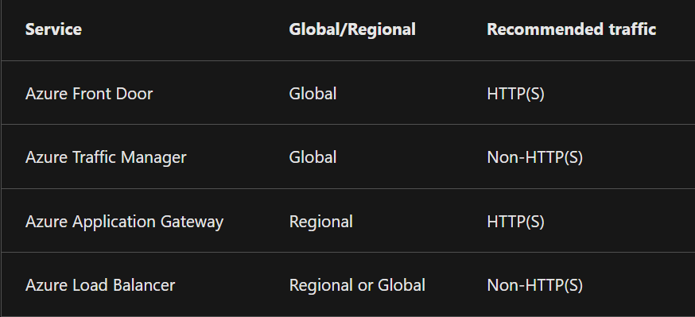
Load Balancing Types
Global Vs Regional
HTTPS vs Non-HTTPS

Slide 4

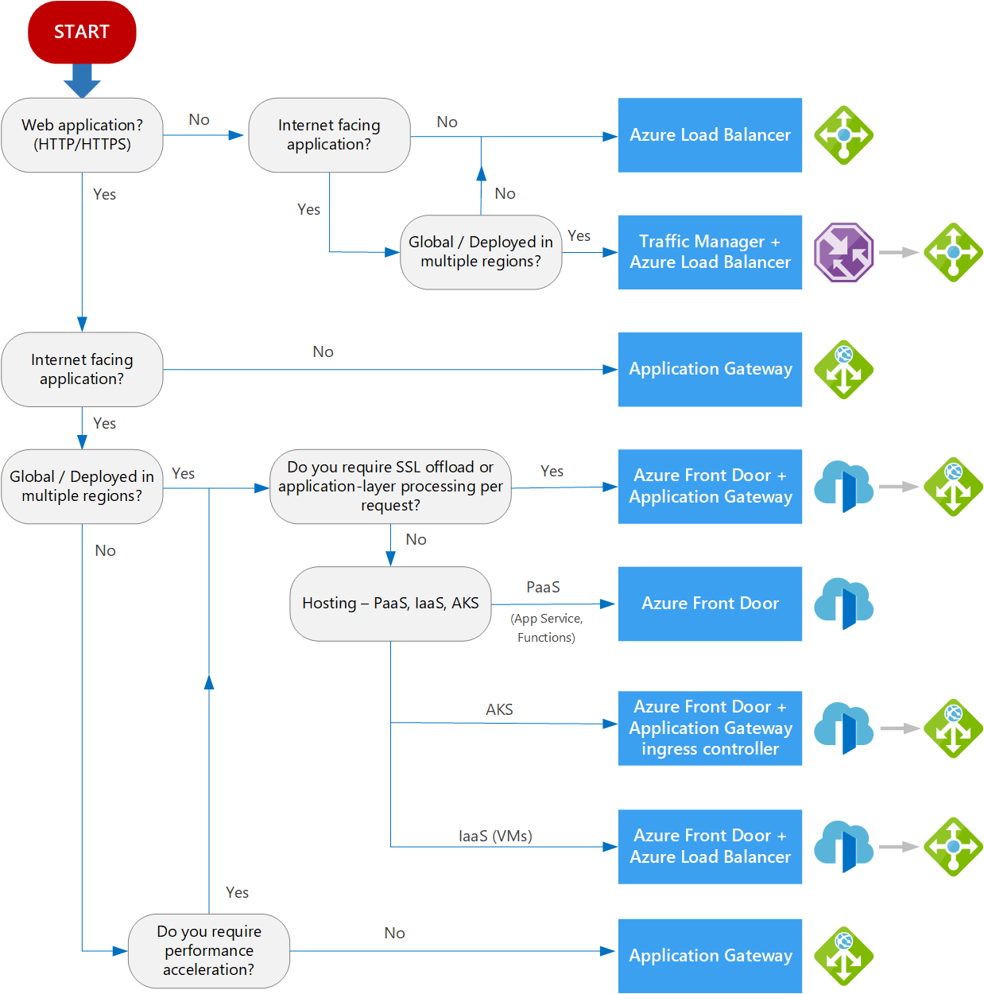
Choosing a Load Balancing solution

Slide 5
Azure Load Balancer Vs Azure Application Gateway
Load Balancer
Application Gateway
Balances Internal and External traffic to VM at Layer-4
Use Pass-through load balancing, reducing latency
Distributes resources within and across zones
Outbound Connectivity to VMs
Configure health probes
Employee port forwarding
IPv6 load balancing
Layer 7 LB for managing web app traffic
SSL/TLS Termination
Autoscaling
Zone Redundancy
WAF
Ingress Controller for AKS
URL-Based routing
Multi-site hosting
Redirection – HTTP (80) to HTTPS (443)
Session Affinity
Connection draining
Rewrite HTTP Headers and URL

Slide 6
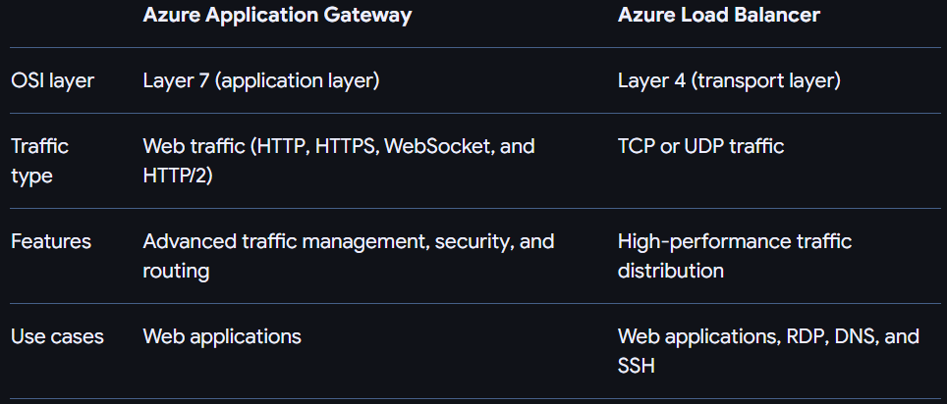
Comparison between LB and AG

Slide 7
Azure Traffic Manager Vs Azure Front Door
Traffic Manager
Front Door
DNS Based Load Balancer for Apps across Global regions
Increase Application Availability
Improves Application performance
Service Maintenance without downtime
Combine Hybrid applications supporting “Failover-to-cloud” scenario
Nested Traffic Manager profiles
Global Load BalancingSSL/TLS Termination
Dynamic Site Acceleration (DSA)
SSL/TLS Offloading
WAF
URL Path-Based Routing
Session Affinity
Customizable Rules Engine
Real-Time Analytics
Notes:
Priority traffic-routing method
Weighted traffic-routing method
Performance traffic-routing method
Geographic traffic-routing method
Multivalue traffic-routing method
Subnet traffic-routing method

Slide 8
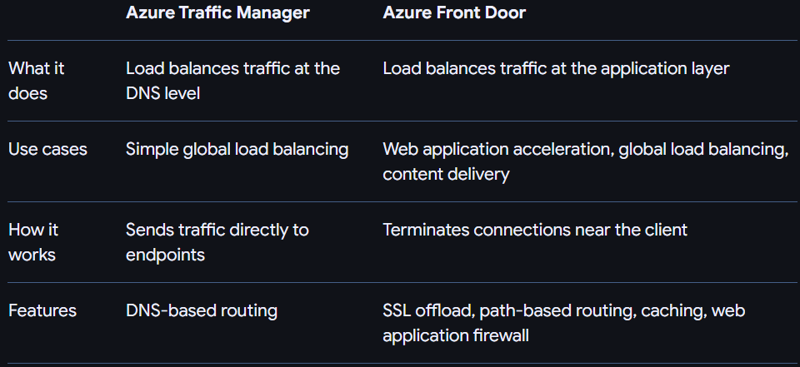
Comparison between Traffic Manager and Front Door

Slide 9

Demo

Slide 10

Q&A

